Slide 1
MSBA Capstone Presentation
Pablo Zarate & Biva Sherchan

Slide 2
Team Introduction
Pablo Zarate
Senior Analyst in WFM Analytics at E-Trade
Formerly in Consumer Banking FP&A for Goldman Sachs
Well-versed in financial markets and macro-economy
Biva Sherchan
Director in WM at Morgan Stanley
Formerly in Asset Management for Goldman Sachs
Well versed in SQL, VBA and BI tools
Notes:
Pablo and Biva speak

Slide 3
Overview
Business Problem
Exploratory Data Analysis (EDA)
Modeling
Final Thoughts
Notes:
Biva

Slide 4

Home Credit – Business Problem
Home Credit aims to serve the underserved population i.e. people with in-sufficient or non-existent credit history, by providing a positive and safe borrowing experience.
Business Problem: Can we predict customers who will have difficulty paying back their loans?
Objective: Build a prediction model tuned for maximum accuracy that will be able to predict the loan repayment chances.
Notes:
Pablo

Slide 5
Exploratory Data Analysis
Dataset: application_train
Information of customer’s credit application
Binary ‘target’ variable with ‘1’ or ‘0’ values
1 = Has issues paying back loan
0 = No issues paying back loan
Data size: (307511, 122)
Variables transformation
In RStudio - converted 23 integer/character variables to categorical
In Python - changed categorical to numerical variables
Notes:
Pablo
1. Converted 'character' variables to factor variables - as they are more memory efficient, better represents ordered relationships and will ensure that plots work as expected.

Slide 6
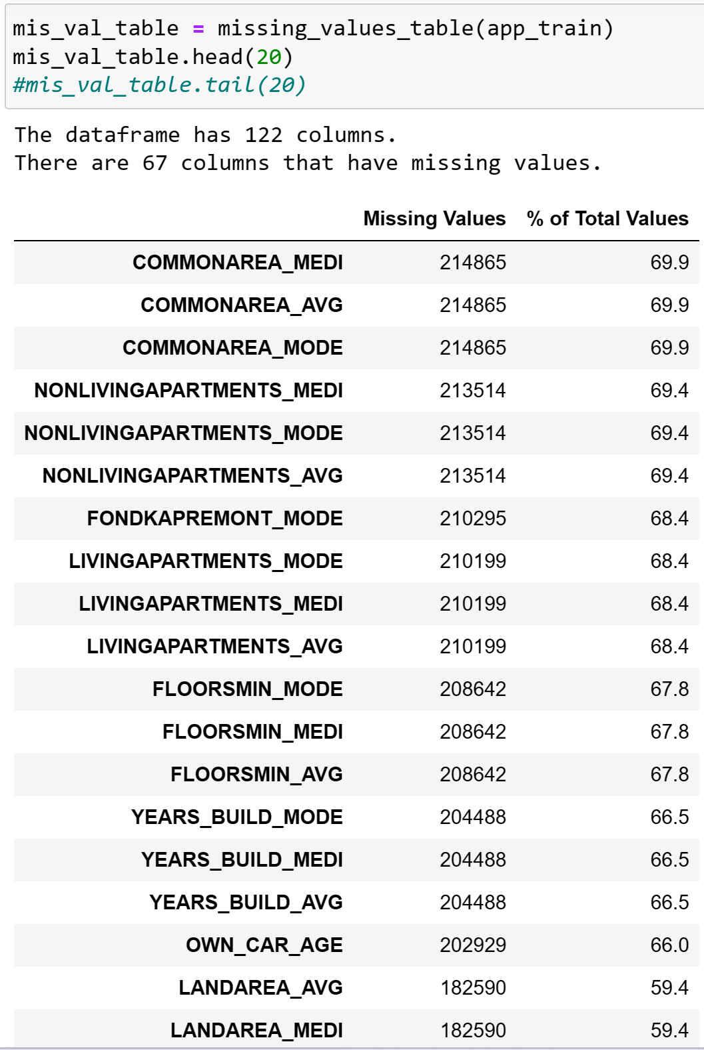
Exploratory Data Analysis
Null Values
Removed columns with more than 25% null values
Removed rows with null values
app_train data size: (244280, 72)
Notes:
Pablo

Slide 7
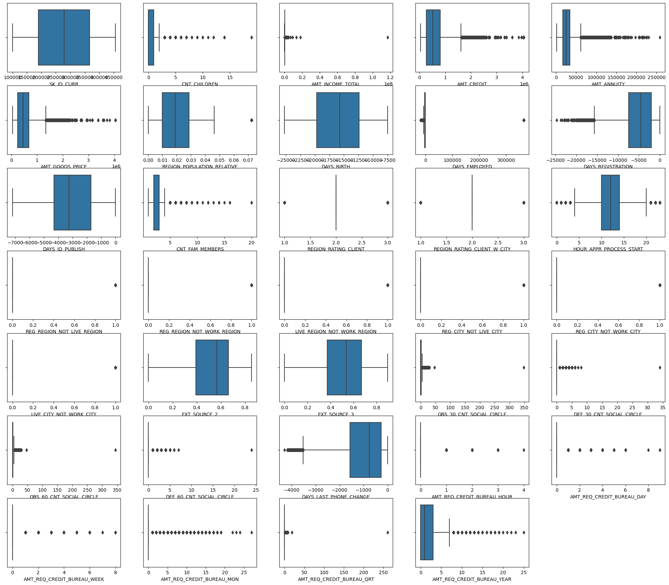
Exploratory Data Analysis
Outliers
Imputed outliers with median values using IQR approach
The interquartile range (IQR) is a measurement of the spread of values in the middle 50%.
If an observation is 1.5 times the interquartile range more than the third quartile (Q3) or 1.5 times the interquartile range less than the first quartile (Q1), it is considered and outlier.
Notes:
Biva

Slide 8
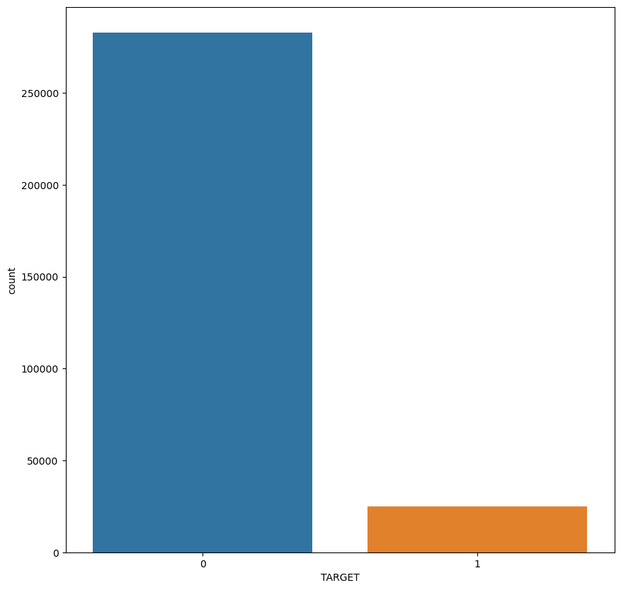
Exploratory Data Analysis
Data imbalance: 92% vs 8%
Notes:
Biva

Slide 9
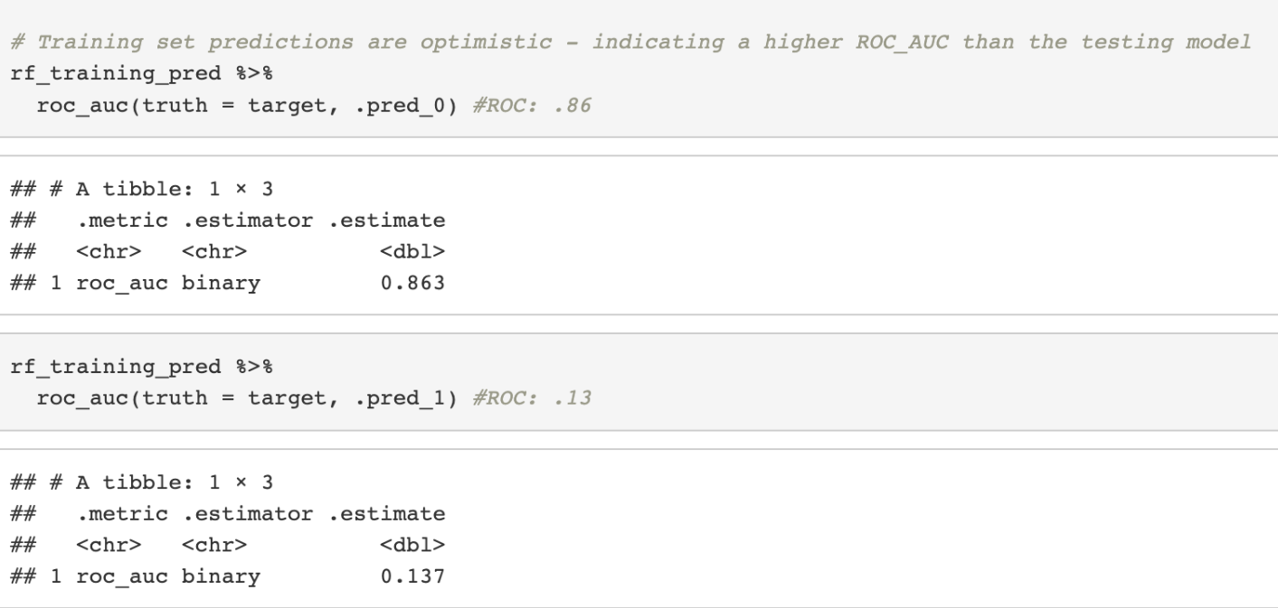
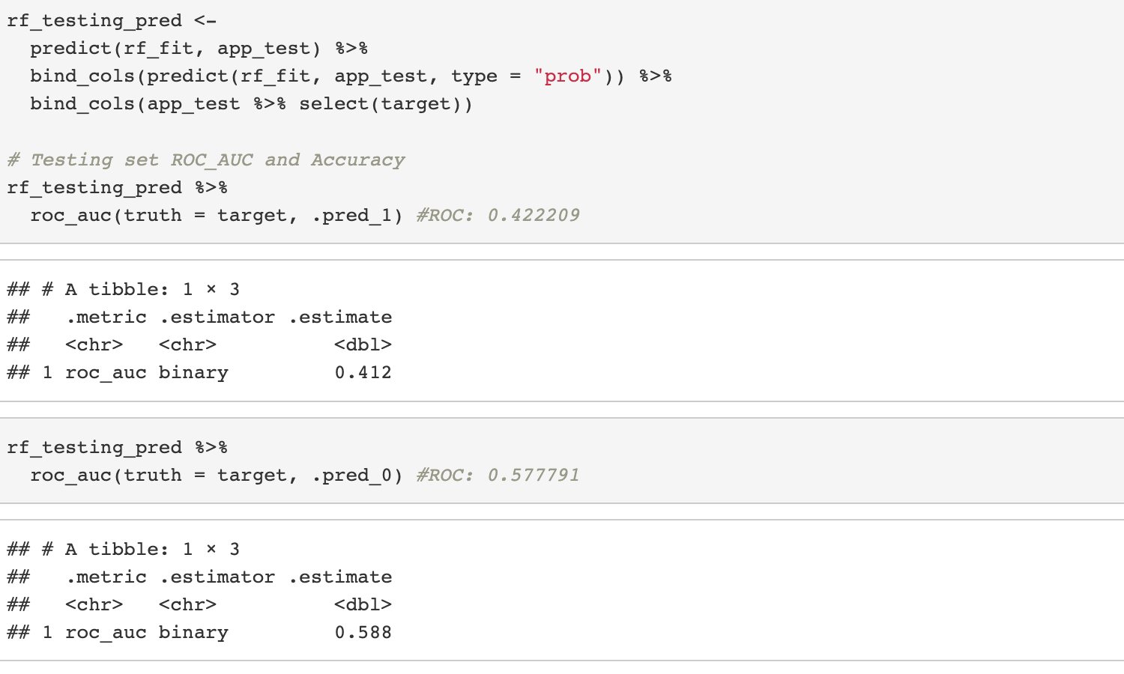
Random Forest - Pablo
Using name_education_type, _amt_credit, flag_own_car and amt_income variables
Difference between Accuracy & Area under the ROC Curve
Accuracy: Number of correctly predicted data points
AUC-ROC: Performance measurement for classification
problems
Higher the AUC-ROC, the better the model is at predicting
0 classes as 0 and 1 classes as 1
Initial ROC/AUC Comparisons - overly optimistic
Notes:
Pablo
The Random Forest model was processed using the application_train dataset and removed all rows that had an ‘NA’. Classification accuracy and the Area under the ROC Curve scores were used to measure model & probability estimate performance. I am only using the name_education_type, amt_credit, flag_own_car and amt_income_total variables for this modeling assignment.
The training set statistics in this Random Forest model are optimistic. It memorizes the training set and re-predicts items from this same dataset, coming into nearly perfect results.
I will use 10-fold cross-validation to re-sample the dataset and see if we can get a model with a ROC-AUC closer to the testing model.

Slide 10
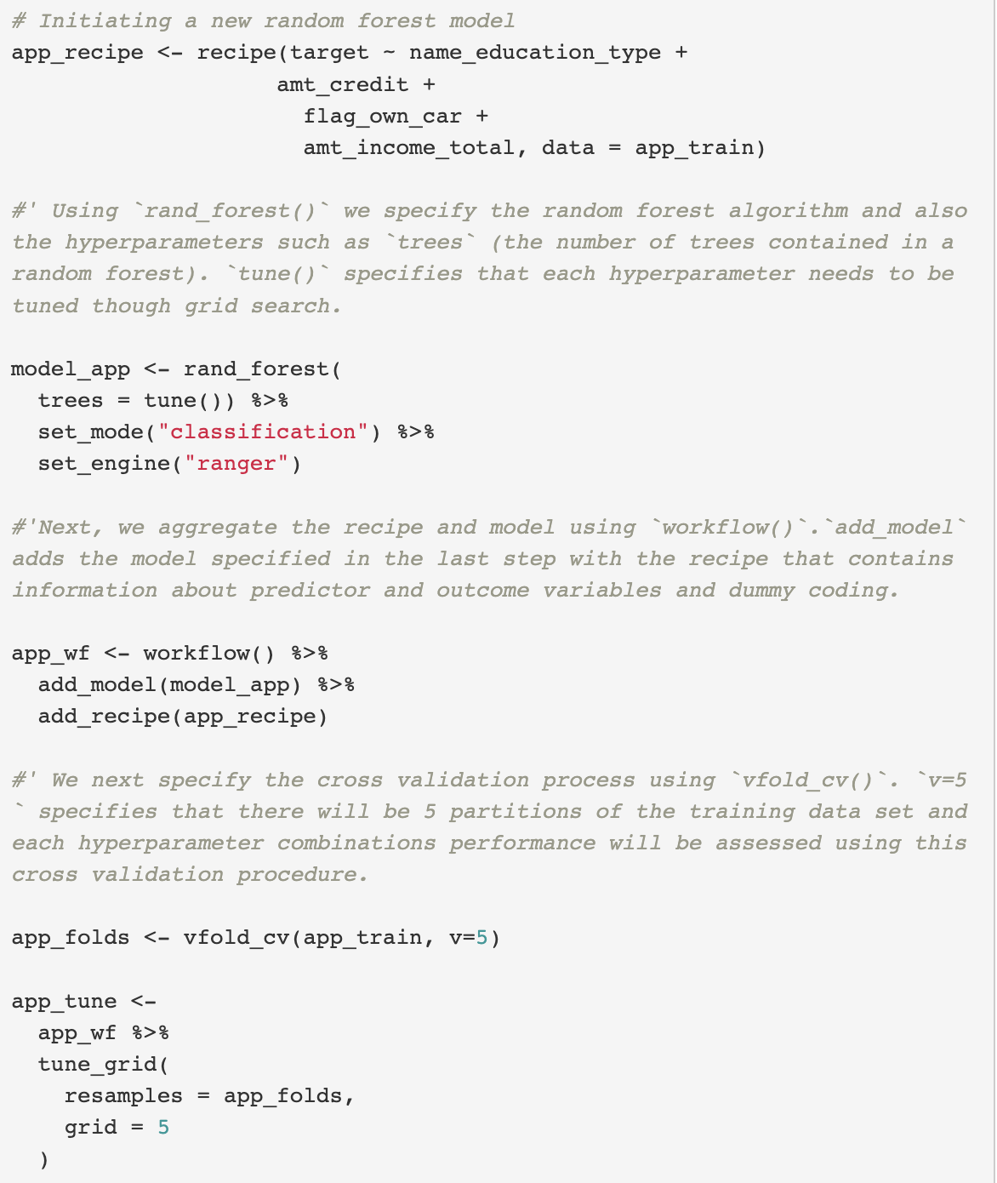
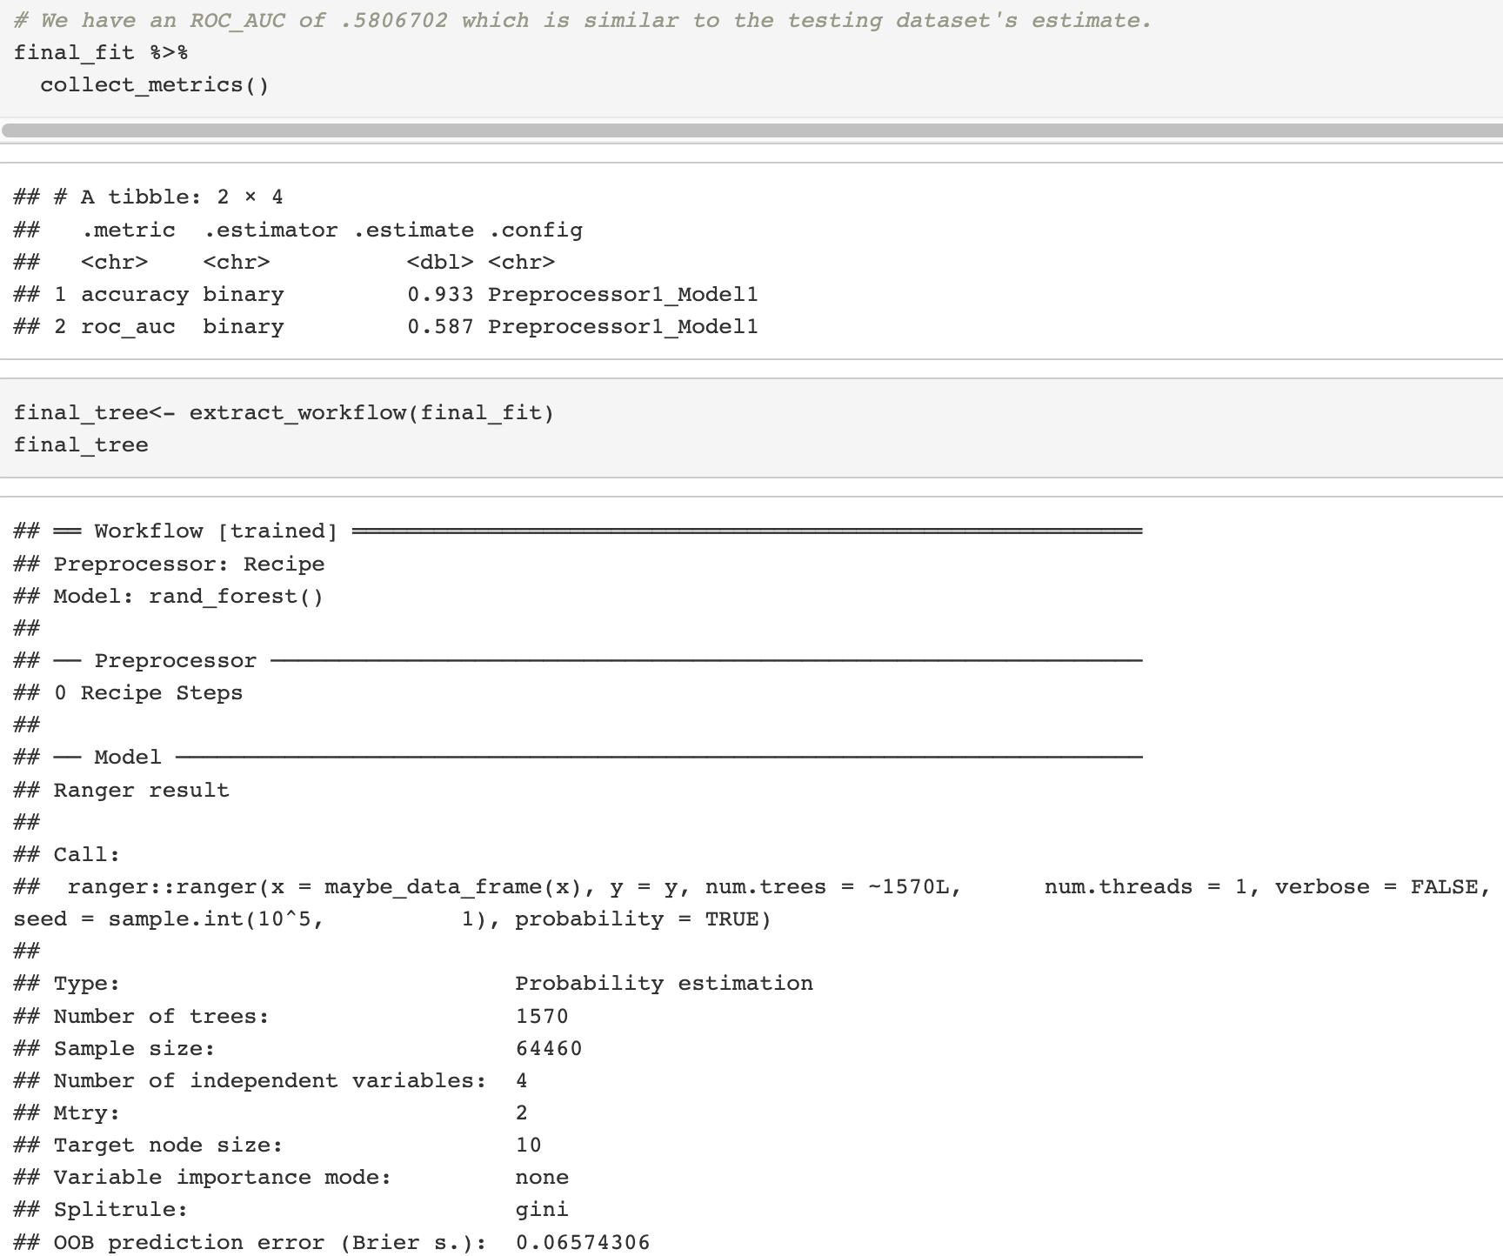
Random Forest - Pablo
Cross-Validation & Model Tuning
Final ROC/AUC Comparison
Notes:
Pablo
Using tune() and cross-validation, we can specify which hyperparameters will be assessed through running a grid search.
At this point, I am running a new random forest model that takes hyperparameter tuning into account. However, I will only be tuning number of trees as assessing other hyperparameters (like minimum number of datapoints and mtry) is causing this model to take a long time to run (+30 minutes).
Our final model has 1,570 trees, and an accuracy of .93 and ROC-AUC of .58, similar to the testing dataset. This model took 30 minutes to process.

Slide 11
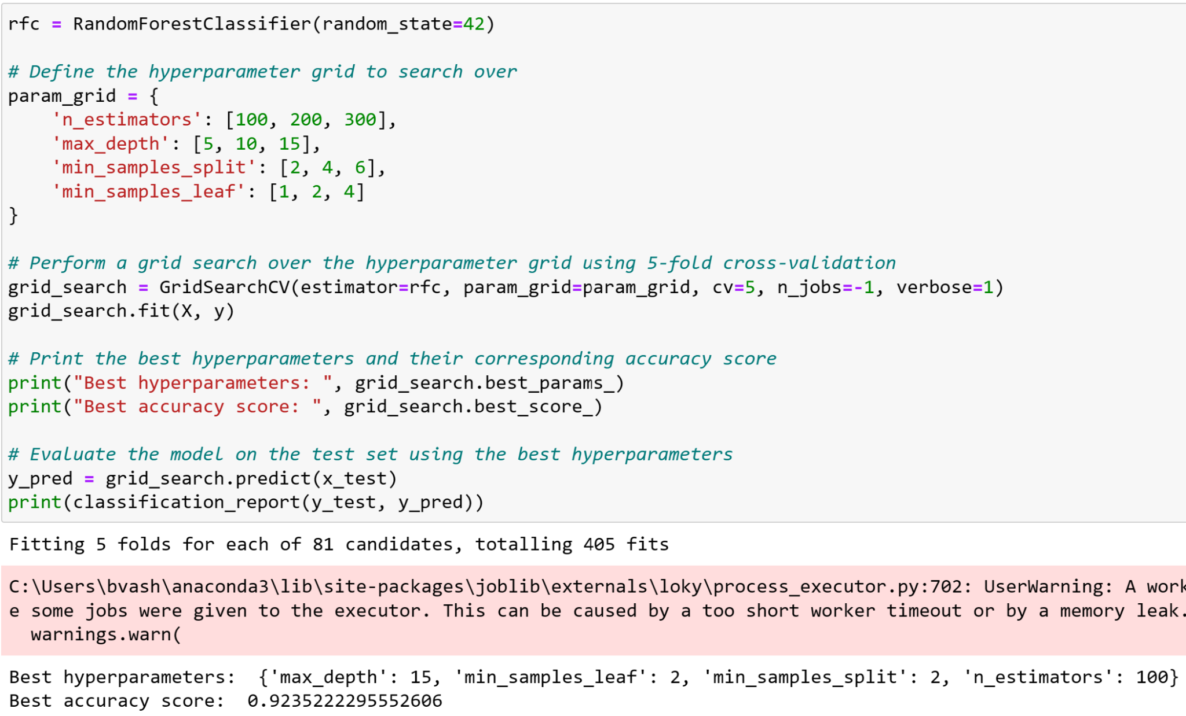
Random Forest - Biva
Accuracy: 0.92
ROC AUC: 0.91
Notes:
Biva

Slide 12
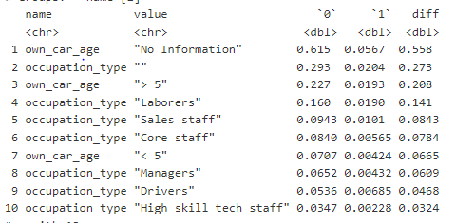
Final Thoughts
Using null values in modeling
Include other data sets into modeling
Proportion of NA values with a ‘1’ target value
Explore other classification models
The ‘own_car_age’ and ‘occupation_type’ NA values have a higher proportion of ‘1’ target values - 5% and 2% respectively
This indicates predictive power
Notes:
Pablo & Biva

Slide 13
Appendix
EDA - Annual Income by Target Variable
EDA - Car Ownership
Modeling - Logistic Regression
Modeling - Gradient Boosting Classifier

Slide 14
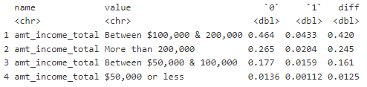
Exploratory Data Analysis – Annual Income by Target Variable
Proportion of annual income by target variable
Half of this dataset has an annual income of between $100,000 and $200,000 at 50%
Majority of ‘1’ target variable makes between $100,000 and $200,000

Slide 15
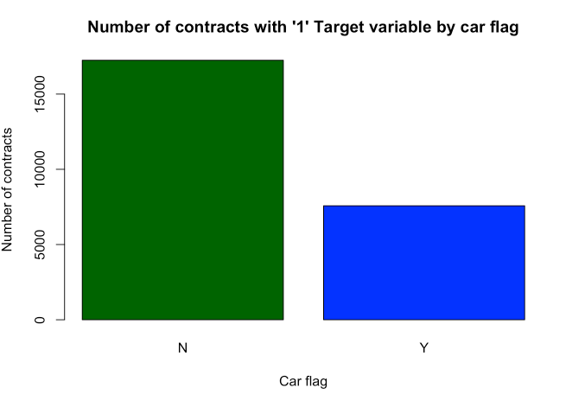
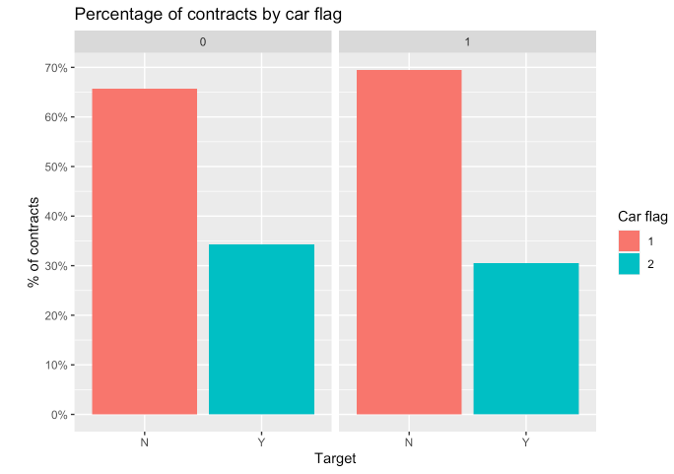
Exploratory Data Analysis – Car Ownership
Nearly 70% of clients in the target variable do not own a car.

Slide 16
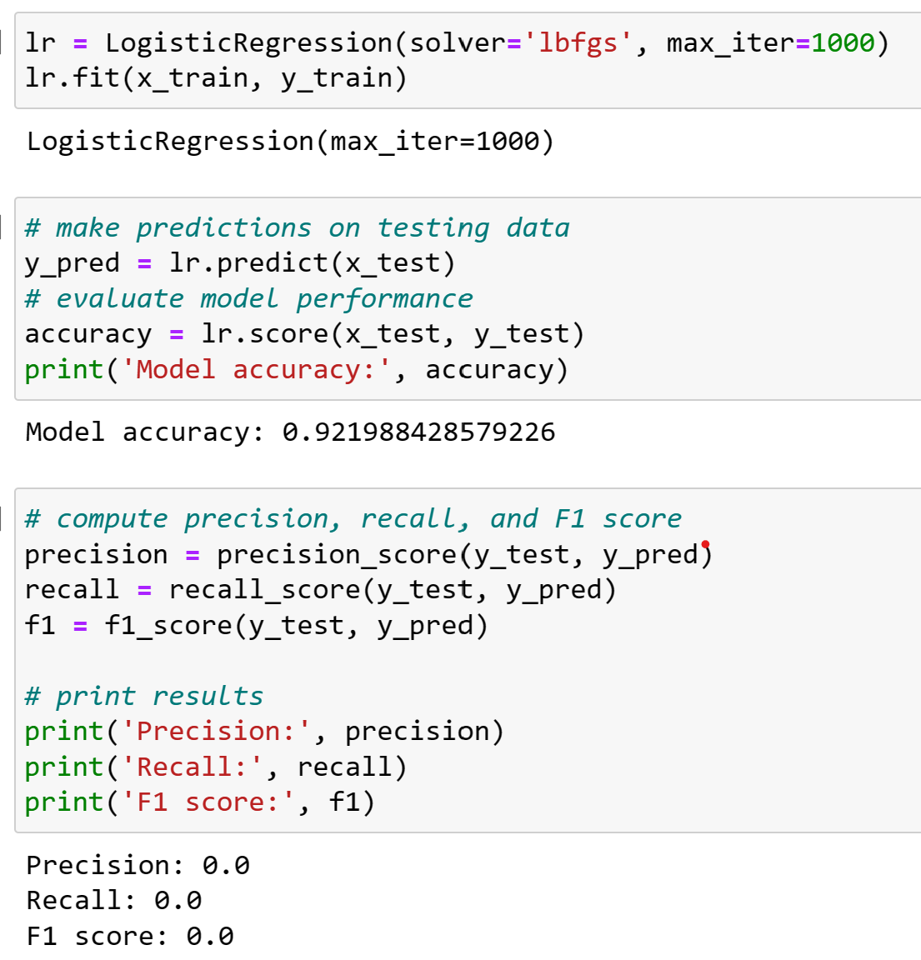
Modeling - Logistic Regression Model
Accuracy: 0.92
Notes:
Biva

Slide 17
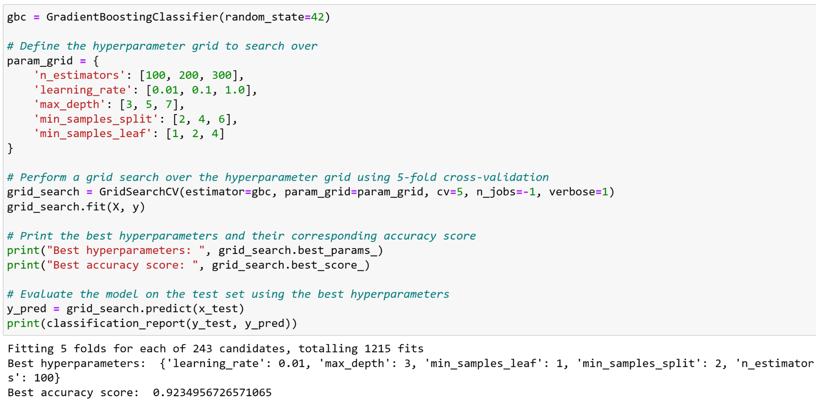
Modeling - Gradient Boosting Classifier
Accuracy: 0.92
Notes:
Biva

